Slide 1
See next pages for Testimonials

Slide 2
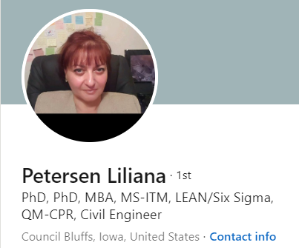
Professor
Business/Entrepreneurship
I strongly recommend Dr. Errol for consulting, mentorship, strategic planning, and negotiation techniques. He recently presented for Project Management Institute Heartland Chapter (PMIH) - a valuable and dynamic webinar that was highly appreciated! Dr. Petersen VP of Programs, PMIH

Slide 3
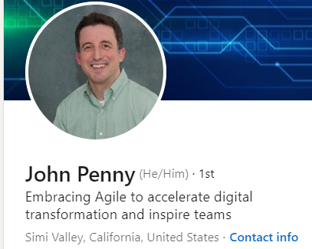
AMGEN
Director, Digital Technology & Innovation
Thank you for a fascinating and informative presentation this evening. You are so right that the skills you teach are for life; so much more impactful than simply thinking of them as business skills. I really appreciate the time that you took to share them with us.

Slide 4
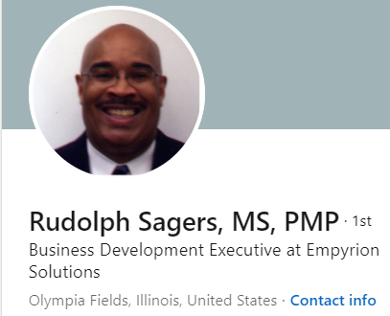
Biz. Dev. Director.
First of all, I would like to personally congratulate Dr. Errol for one of the finest and most concise presentations on negotiations that I have ever attended! I have negotiated multi-million-dollar contracts for companies such as IBM, Unisys, AT&T and I am always seeking to learn and pick up new ways to approach negotiations. Dr. Errol's presentation to our local Chicago PMI chapter was just exceptional and I learned a lot! I am currently involved in an active negotiation with a large metropolitan city in the Midwest and the points that were made during the presentation will most definitely assist me in my negotiations. I was so impressed with Dr. Errol's presentation that I immediately ordered his book from Amazon to assist me in my negotiation planning.

